Slide 1

Site-to-Site VPNs: Bridging On-Premises and Cloud Environments

Slide 2
What is a Site-to-Site VPN?
Definition: A Site-to-Site VPN securely connects two or more networks over the internet.
Function: It establishes a virtual encrypted tunnel between the networks for secure data transmission.
Usage: Commonly used for connecting branch offices to central headquarters.

Slide 3

How does a Site-to-Site VPN Work?
Data Encryption
Tunneling:
Configure VPN Devices
Exchange VPN Configuration Details
Establish VPN Tunnels
Verify Tunnel Status
Troubleshoot and Optimize
VPN Gateway Handling
Routing and Forwarding:
Mutual Authentication
Security Associations (SA)
Continuous Monitoring and Maintenance

Slide 4
How Does a Site-to-Site VPN Work?
Data Encryption and Tunneling
Mutual Authentication and Security Associations (SA)
Routing and Forwarding
Continuous Monitoring and Maintenance

Slide 5
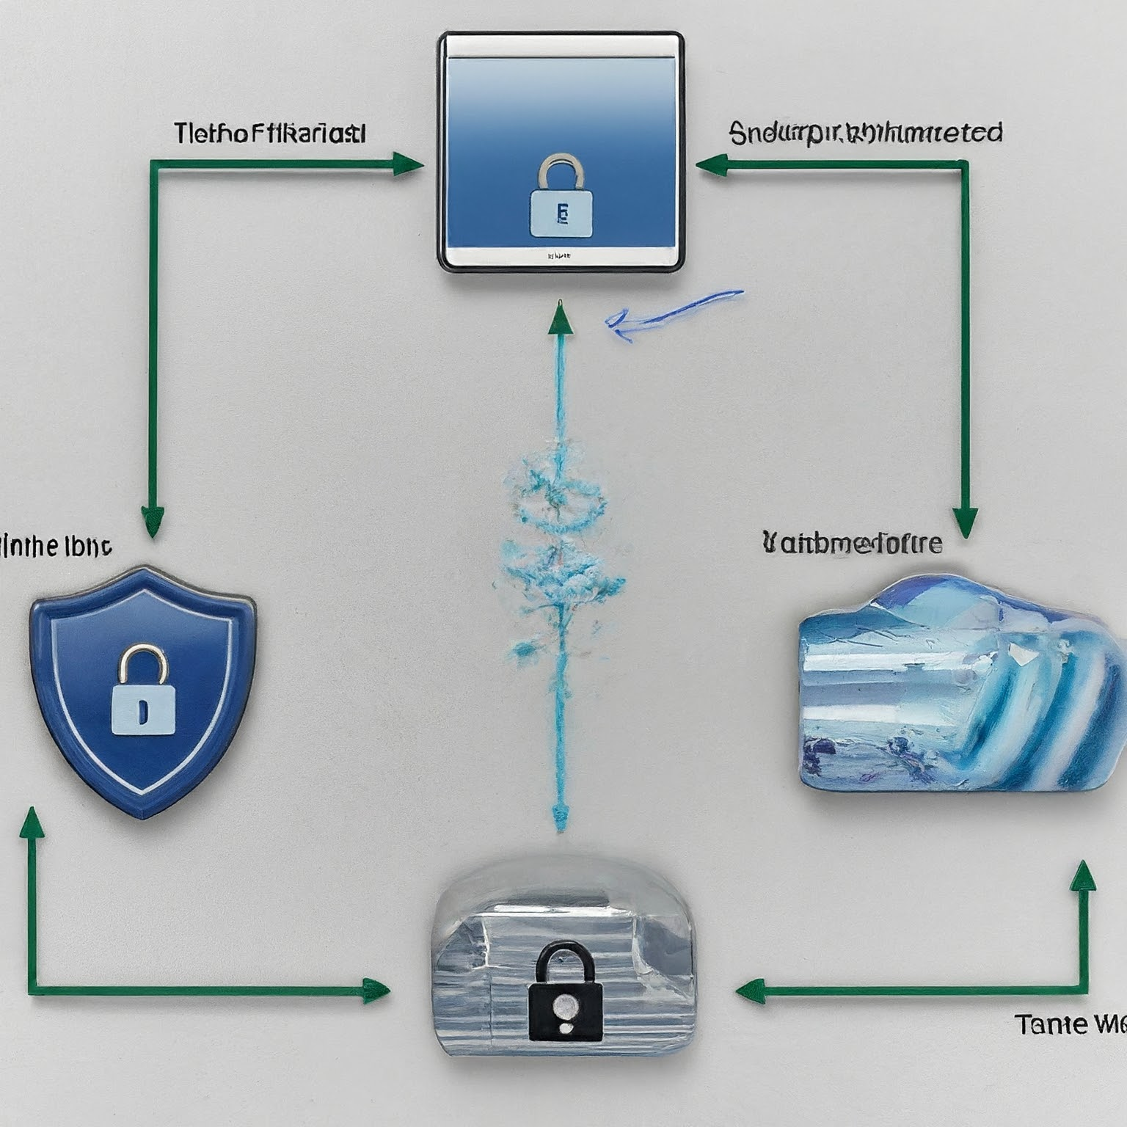
How Does a Site-to-Site VPN Work?
A site-to-site VPN typically involves the following components:
On-premises VPN device: This device is located at our on-premises network and manages the VPN connection.
Cloud VPN gateway: This is a virtual appliance provided by a cloud provider that handles the VPN connection on the cloud side.
Encrypted tunnel: The VPN creates a secure tunnel over the
internet, encrypting all data traffic that passes through it.
Public IP address: Both the on-premises VPN device and the
cloud VPN gateway needs public IP addresses to establish the
connection.

Slide 6
Components of Site-to-Site VPN
On-Premises Network Components:
Routers/Firewalls: Manage network traffic and enforce security policies.
VPN Gateway: Establishes and manages the VPN tunnel.
Cloud Network Components:
Virtual Private Gateway

Slide 7

Making a Site-to-Site VPN Connection
The specific steps for creating a site-to-site VPN will vary depending on the cloud provider and on-premises VPN device.
However, the general process typically involves the following steps:
Configure your on-premises VPN device.
Configure your cloud VPN gateway.
Establish the VPN connection.
Verify the connection and troubleshoot any
issues.

Slide 8

Benefits of Using a Site-to-Site VPN
Secure data transfer: Site-to-site VPNs encrypt data traffic, protecting it from unauthorized access.
Improved application access: Employees can securely access cloud-based applications from their on-premises devices.
Enhanced disaster recovery: Site-to-site VPNs can be used to replicate data to the cloud for disaster recovery purposes.
Increased scalability: Cloud resources can be easily scaled up or
down as needed, without impacting your on-premises network.
Cost savings: Site-to-site VPNs can help you reduce costs by
consolidating infrastructure and eliminating the need for dedicated
private lines.

Slide 9
Conclusion
Site-to-Site VPNs play a crucial role in securely connecting on-premises infrastructure to cloud environments.
By implementing robust security measures and optimization techniques, organizations can leverage Site-to-Site VPNs to achieve seamless integration and enhanced flexibility in their IT infrastructure.
As the demand for cloud services continues to grow, Site-to-Site VPNs will remain a vital component of modern network architecture.

